Slide 1
Efficient Record Deduplication and Linkage Using LSH and Machine Learning
Group 5 Members:
Gefei Wu
Hongnan Huang
Zhengguang Li

Slide 2
TABLE OF CONTENTS
Introduction
Data Preprocessing
01
02
Candidate Pair Generation
Feature Engineering
03
04
Project goals (Deduplication + Record Linkage)
Dataset overview (Primary, Alternate, Test)
Motivation for using LSH and ML
Normalization steps (lowercasing, unidecode, regex cleaning)
Column structure (norm field creation)
MinHash LSH
Blocking Key Design
Candidate Extraction Strategy (top-N filtering, parallel matching)
Jaro-Winkler, Levenshtein, Token Set Ratio
Soundex, Prefix Match, Jaccard Similarity

Slide 3
TABLE OF CONTENTS
Labeling & Sampling
Model Training
05
06
Thresholding & Evaluation
Conclusion & Future Work
07
08
How positive/negative labels are defined
Why downsampling is necessary (class imbalance)
Model choice and hyperparameters
Training input/output
Why Random Forest is suitable
Selecting a probability threshold
Balancing precision and recall
Evaluation metrics (accuracy, F1)
Summary of contributions
Performance achieved
Possible improvements (e.g., deep learning, more sophisticated blocking)

Slide 4
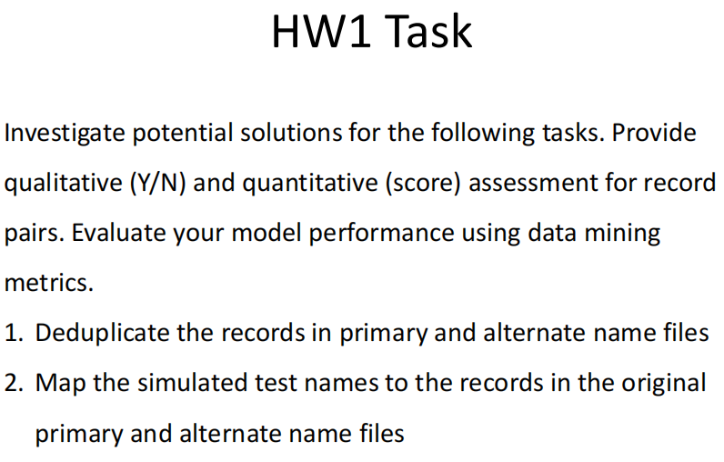
1. Project Overview
Objective:
Deduplication: Eliminate duplicates within single datasets (e.g., Primary, Alternate).
Record Linkage: Match variant entries in a Test dataset to their corresponding records in the original datasets.
Methodology:
Combine Locality-Sensitive Hashing (LSH) with blocking-based indexing and supervised learning to create an efficient and scalable solution for entity resolution.
Literature Support
Traditional blocking methods (Soundex & prefix-based keys) were used alongside LSH to further optimize pair generation.
— Supported by Betancourt & Steorts (2014)

Slide 5

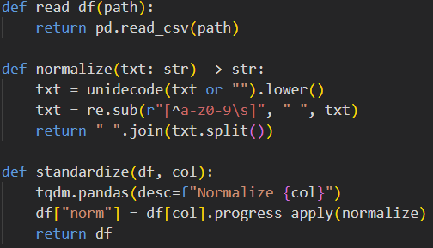
2. Data Preprocessing
Normalization Pipeline:
Convert to lowercase and remove diacritics via unidecode.
Strip non-alphanumeric characters using regular expressions.
Remove redundant whitespace.
Goal:
Standardize text to minimize superficial variations and maximize the quality of matching.

Slide 6
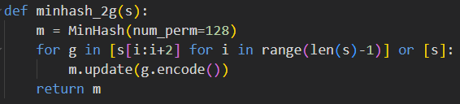
3. Candidate Pair Generation
Goal:
Drastically reduce the number of record comparisons by preselecting candidate pairs likely to match.
MinHash LSH
Technique:
Use MinHash signatures to index and query records with similar token patterns.
Insight:
This function produces a compact signature representing each record’s 2-gram shingles, enabling efficient similarity querying.

Slide 7
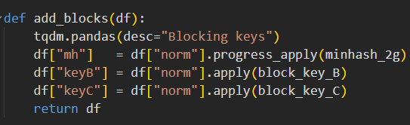
3. Candidate Generation – Blocking Keys
Purpose:
Group records with similar phonetic or structural patterns to further reduce the search space.
block_key_B: First letter + scaled length.
block_key_C: Soundex code + first 3 characters.
Assigning Blocking Information
Result:
Each record is annotated with MinHash and blocking keys to support hybrid candidate pair extraction.

Slide 8
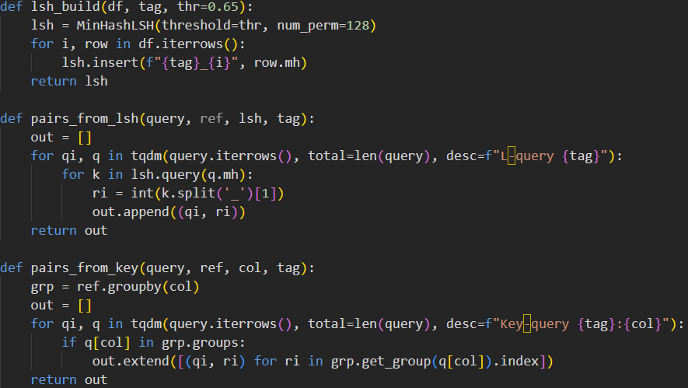
3. Candidate Pair Extraction
lsh_build(df, tag, thr=0.65)
Builds an LSH index from the df DataFrame using MinHash signatures, enabling fast similarity-based lookup.
pairs_from_lsh(query, ref, lsh, tag)
Queries the LSH index for each record in query to find approximate matches from ref.
Highlights:
Combines LSH and blocking.
Ranks candidates using fuzz.WRatio.
Efficient top-N pruning for each query record.
pairs_from_key(query, ref, col, tag)
Performs blocking by grouping records based on a shared blocking key (e.g., keyB, keyC) and returns all matching index pairs.

Slide 9
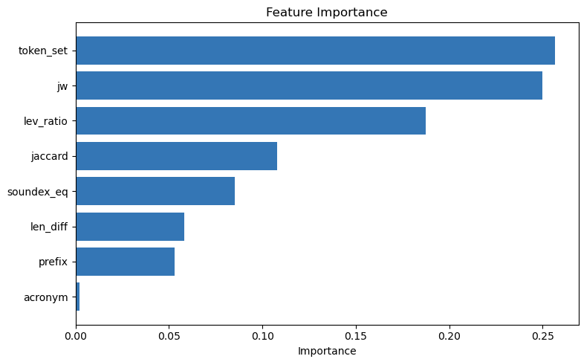
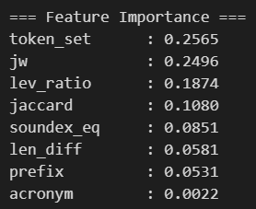
4. Feature Engineering
I used the feature importances from our trained Random Forest Classifier to quantify each feature's contribution to the final classification.
For each candidate pair, we extract discriminative features:
jw: Jaro-Winkler similarity.
lev_ratio: Levenshtein distance ratio.
token_set: Token-based fuzzy matching.
short_prefix: Common prefix & length similarity.
soundex_eq: Phonetic code equality.
jaccard: Set intersection over union of word tokens.
❌ Dropped acronym feature due to low importance (0.0022)
✅ Focused on more predictive features: token_set, jw, lev_ratio...

Slide 10

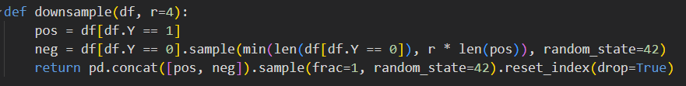
5. Labeling and Sampling
Label Assignment:
Downsampling:
⚙️ Why r = 4?
We empirically tuned the parameter r, which controls the negative-to-positive ratio, and found that r = 4 consistently led to the best model performance in terms of precision and recall.
This setting balances between:
Retaining sufficient negative examples for robust learning
Avoiding class imbalance that could overwhelm the model

Slide 11
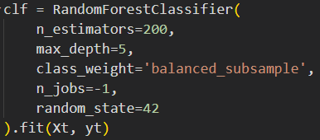
6. Random Forest Model Training
Model Insights:
Handles non-linearity and feature interactions.
Efficient with imbalanced data via balanced_subsample.
Parallelized training using n_jobs=-1.

Slide 12
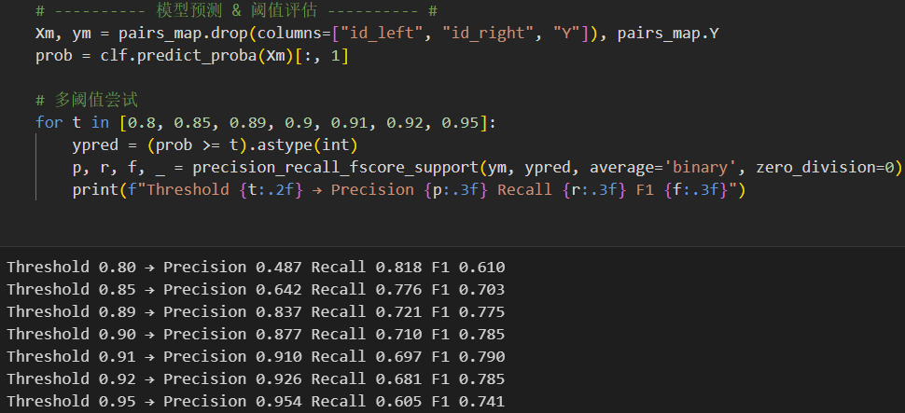
7. Thresholding & Evaluation
Post-training strategy:
Predict probabilities of a match.
Tune classification threshold (e.g., 0.85) to maximize F1.
Outcome:
Improves precision-recall trade-off depending on application need (e.g., stricter deduplication or broader linkage).

Slide 13

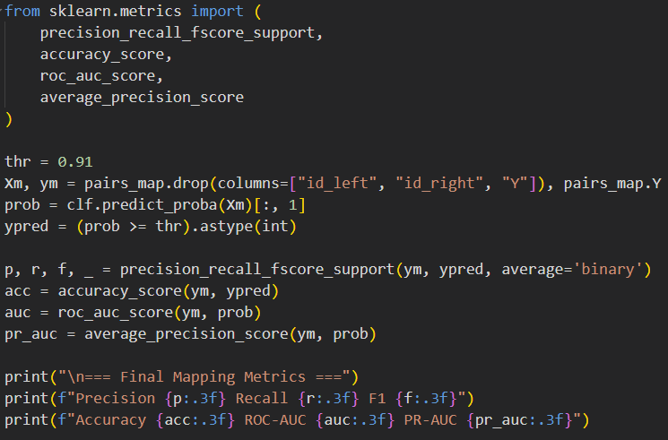
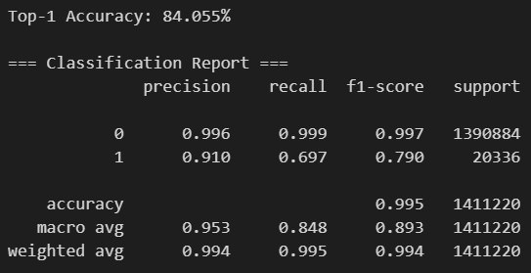
7. Thresholding & Evaluation
These results demonstrate that the model is highly accurate overall and maintains strong performance in identifying true matches.

Slide 14
8. Conclusion & Future Work
🎯 Summary of Contributions
Developed a scalable and accurate entity resolution pipeline combining:
Text normalization
Blocking (LSH + rule-based)
String similarity feature engineering
Supervised learning via Random Forest
Designed and implemented an efficient candidate pair generation module using:
MinHash-based Locality-Sensitive Hashing (LSH)
Custom blocking keys (prefix, phonetics)
Evaluated model performance with a comprehensive set of classification metrics.

Slide 15
8. Conclusion & Future Work
🔮 Future Work
🔍 Improve Recall: Incorporate threshold tuning per block or cost-sensitive classification to capture more true matches.
🤖 Deep Learning: Explore Siamese neural networks or transformer-based encoders (e.g., BERT) for semantic similarity modeling.
🧱 Advanced Blocking Techniques: Apply learned blocking models (e.g., DNF blocking, adaptive LSH) for better pair coverage.
📊 Active Learning: Incorporate user feedback to iteratively refine model via interactive labeling.

Slide 16
Literature Support
Entity Resolution Motivation & Techniques
Entity resolution is essential in domains where unique identifiers are missing.
LSH and blocking techniques provide computational speed-ups while preserving accuracy.
Supervised learning (e.g., Random Forest) offers scalable, flexible modeling with robust performance.
Key References:
Steorts, R. C., Kaplan, A., Betancourt, B., Chen, B., et al. Record Linkage Tutorial (2020)
Christen, P. Data Matching: Concepts and Techniques for Record Linkage, Entity Resolution, and Duplicate Detection (2012)
Fellegi, I. P., & Sunter, A. B. A Theory for Record Linkage (1969)Gradient abstract blurred covers collection

Slide 17
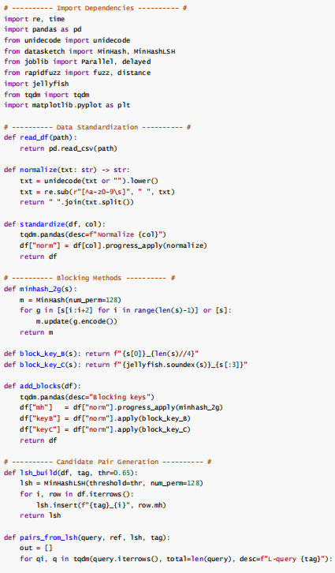
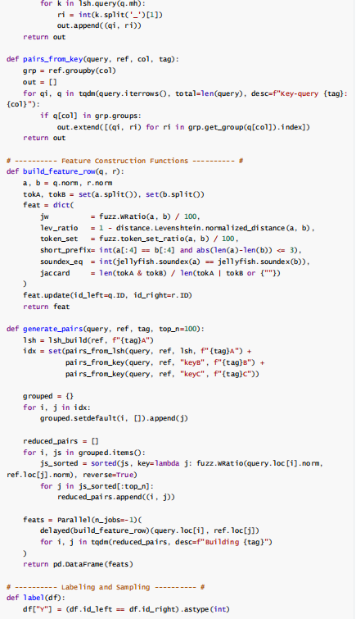
Code presentation

Slide 18
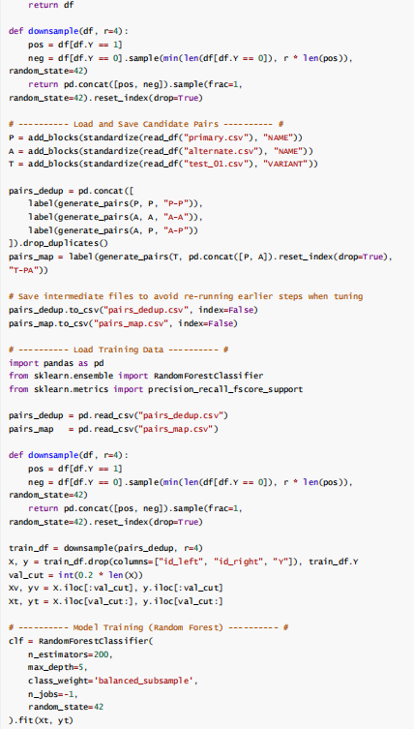
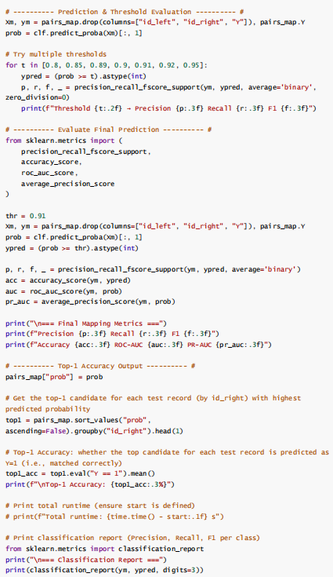
Code presentation

Slide 19
THANKS!
Do you have any questions?
2682247439@qq.com
+133 5553 6798
https://github.com/CinderellaBoy/Record-Linkage

